Slide 1

Department of Computer Engineering
Sequential Logic Design – Synchronous Counter Part II
1

Slide 2
Points covered
Department of Computer Engineering
Introduction
Synchronous Counter (IC 74191)
IC Verification (up and down counter)
2

Slide 3
Department Vision & Mission
Department of Computer Engineering
Vision
Achieve academic excellence through education in computing, to create intellectual manpower to explore professional, higher educational and social opportunities.
Mission
To impart learning by educating students with conceptual knowledge and hands on practices using modern tools, FOSS technologies and competency skills there by igniting the young minds for innovative thinking, professional expertise and research.

Slide 4
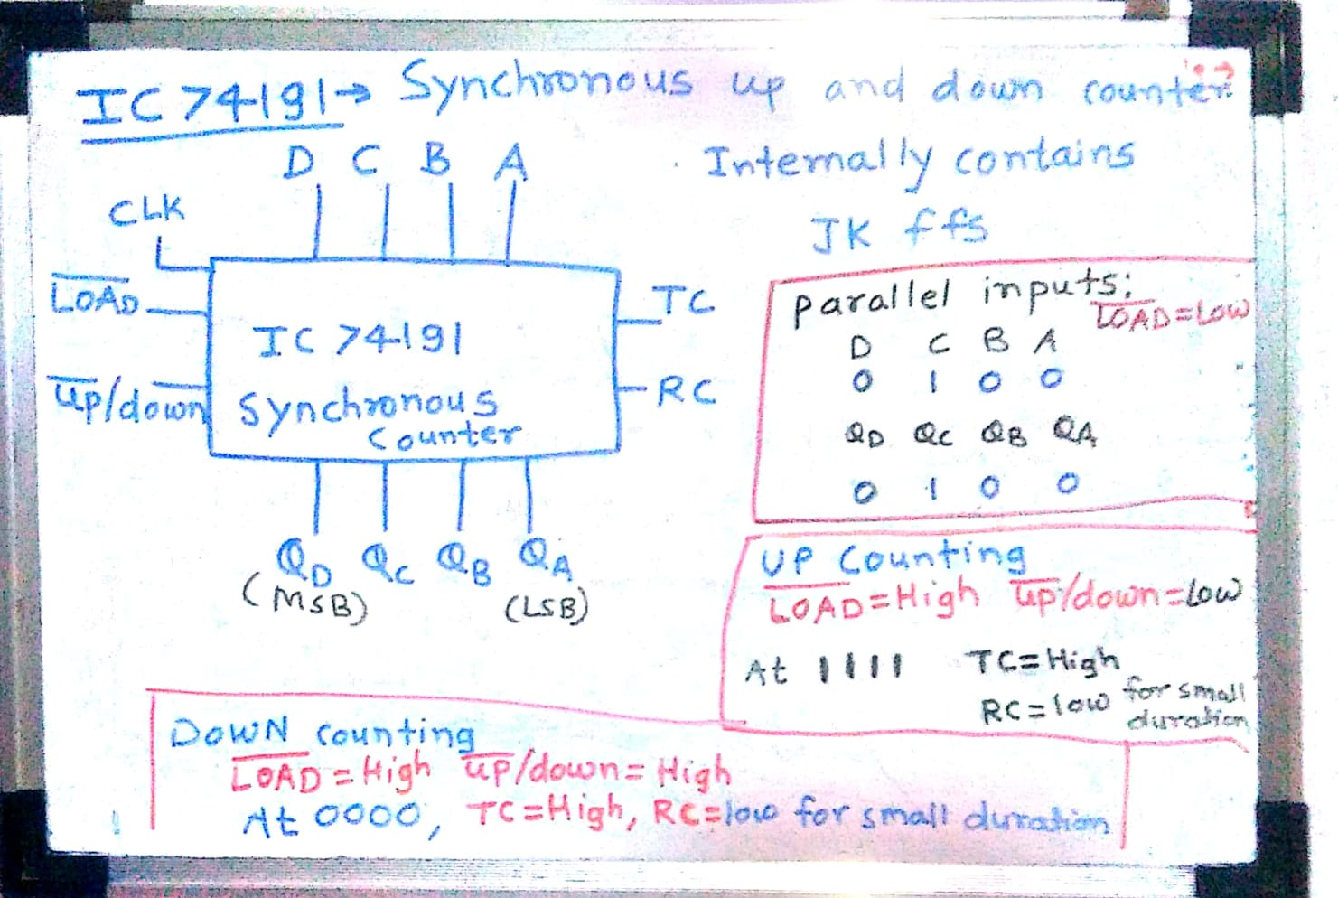
Department of Computer Engineering

Slide 5
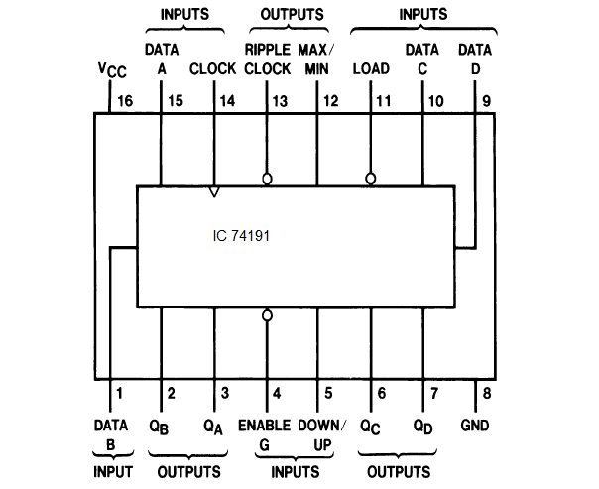
Department of Computer Engineering

Slide 6
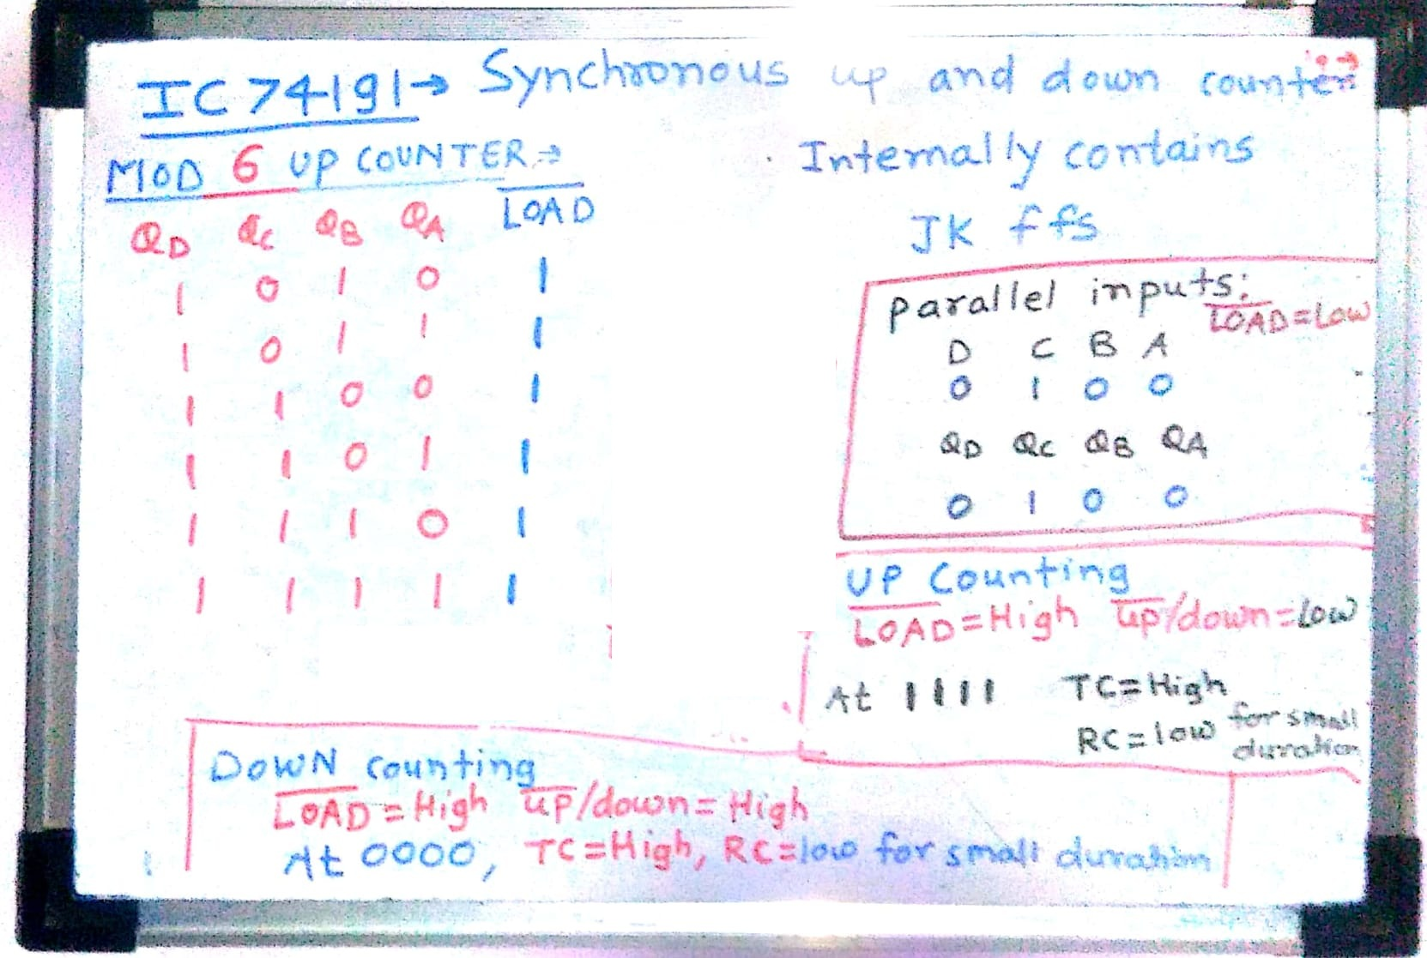
Department of Computer Engineering

Slide 7
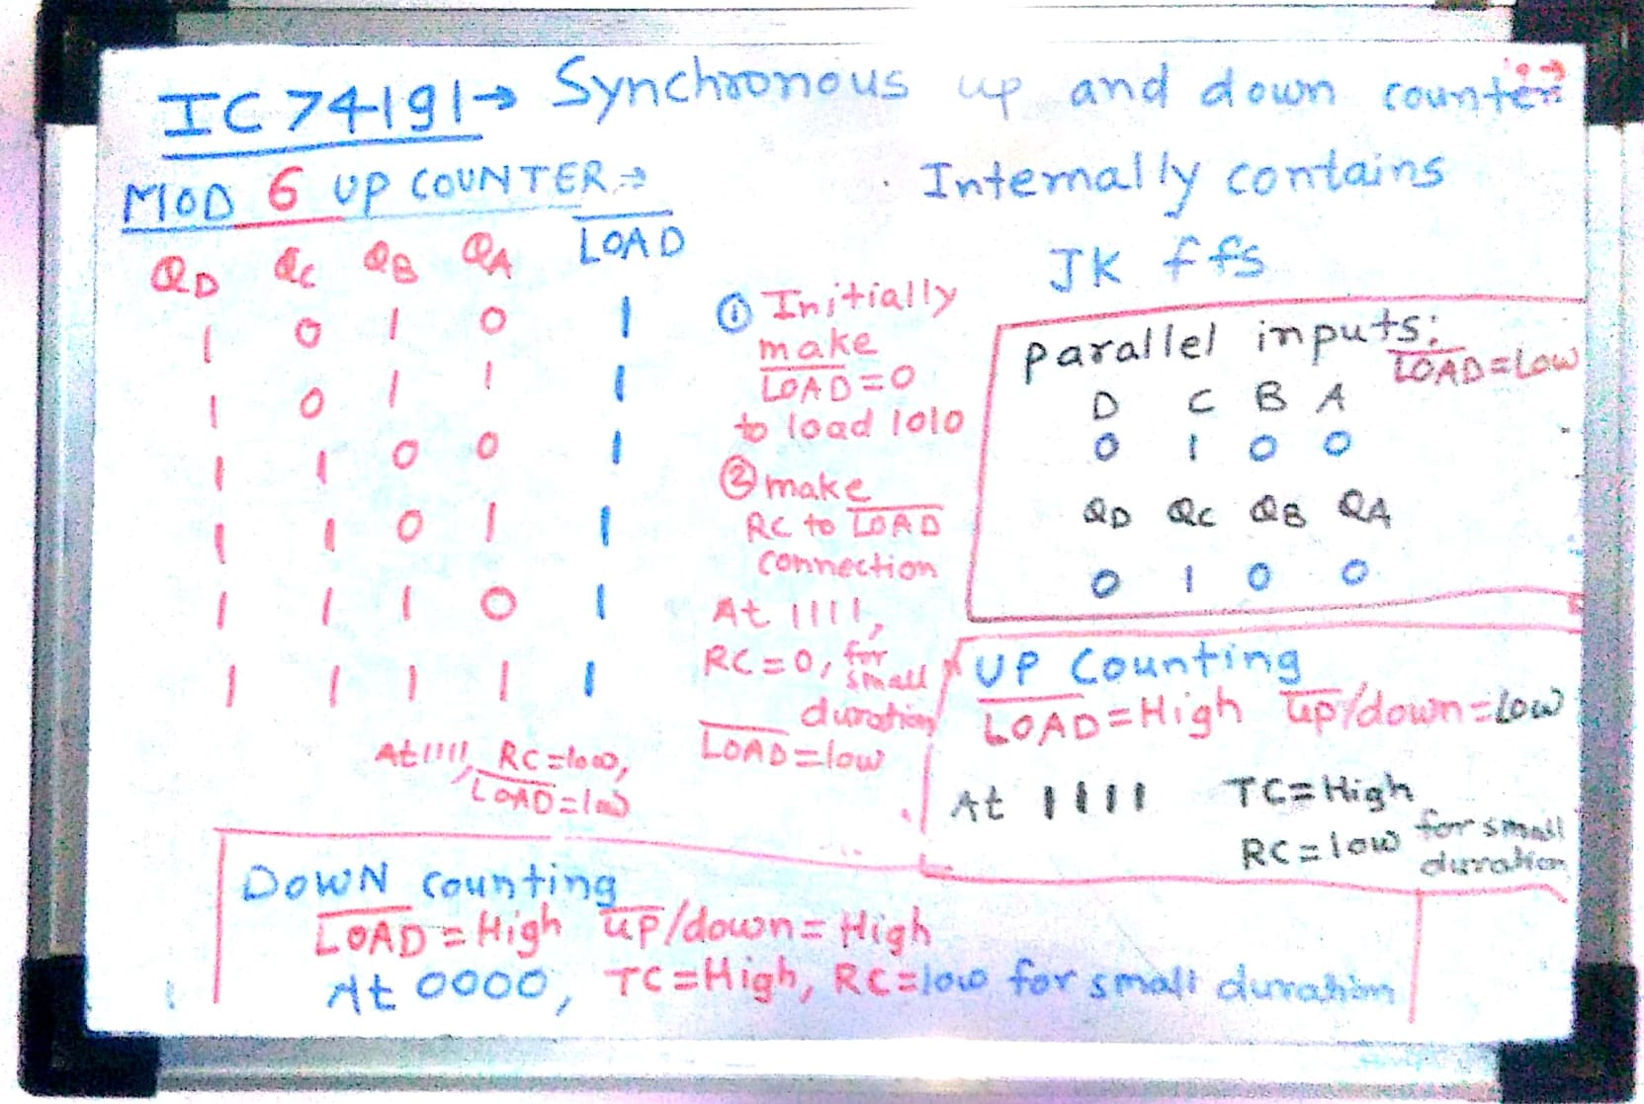
Department of Computer Engineering

Slide 8
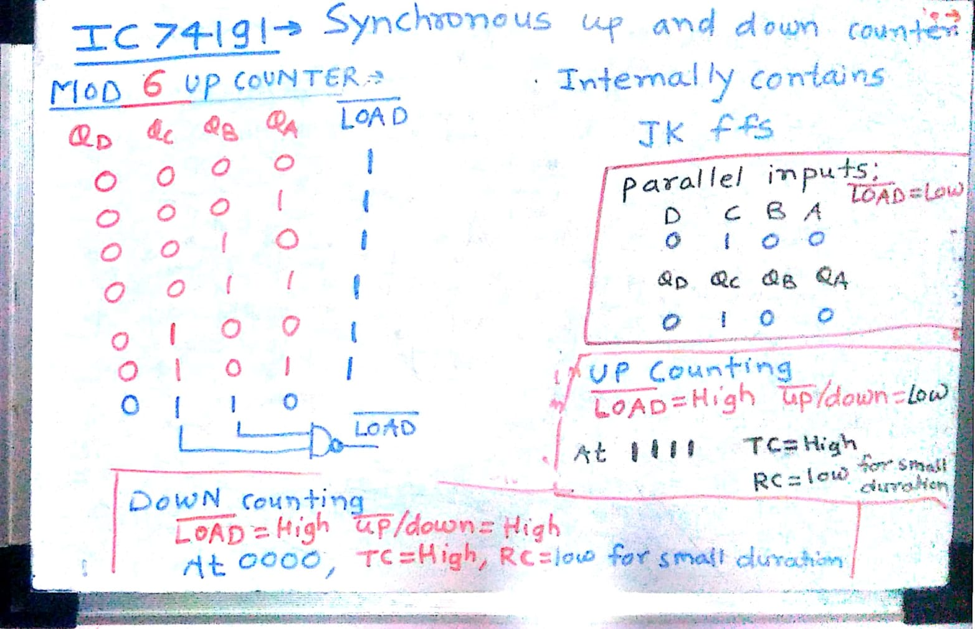
Department of Computer Engineering

Slide 9
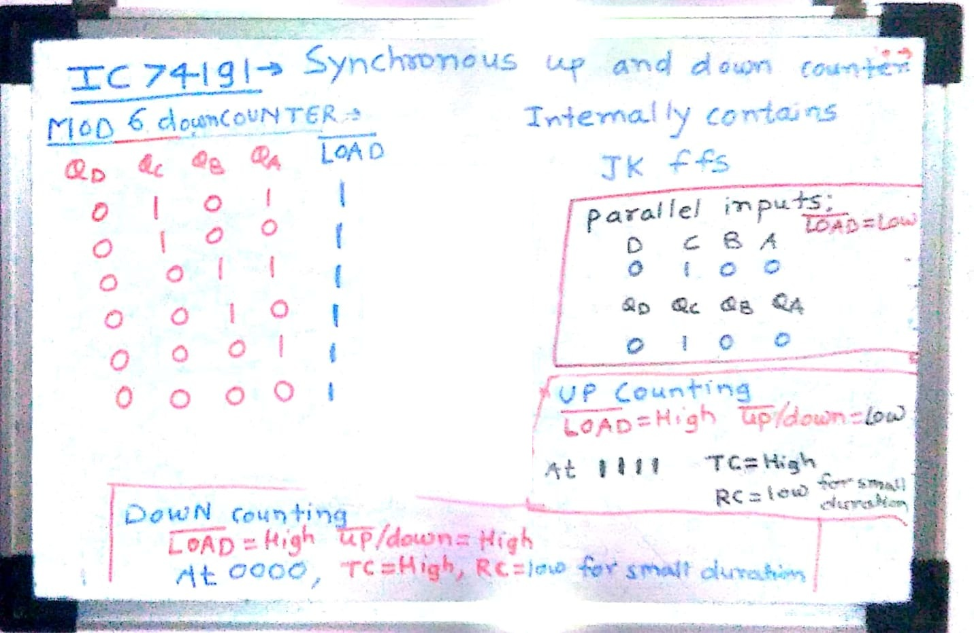
Department of Computer Engineering

Slide 10
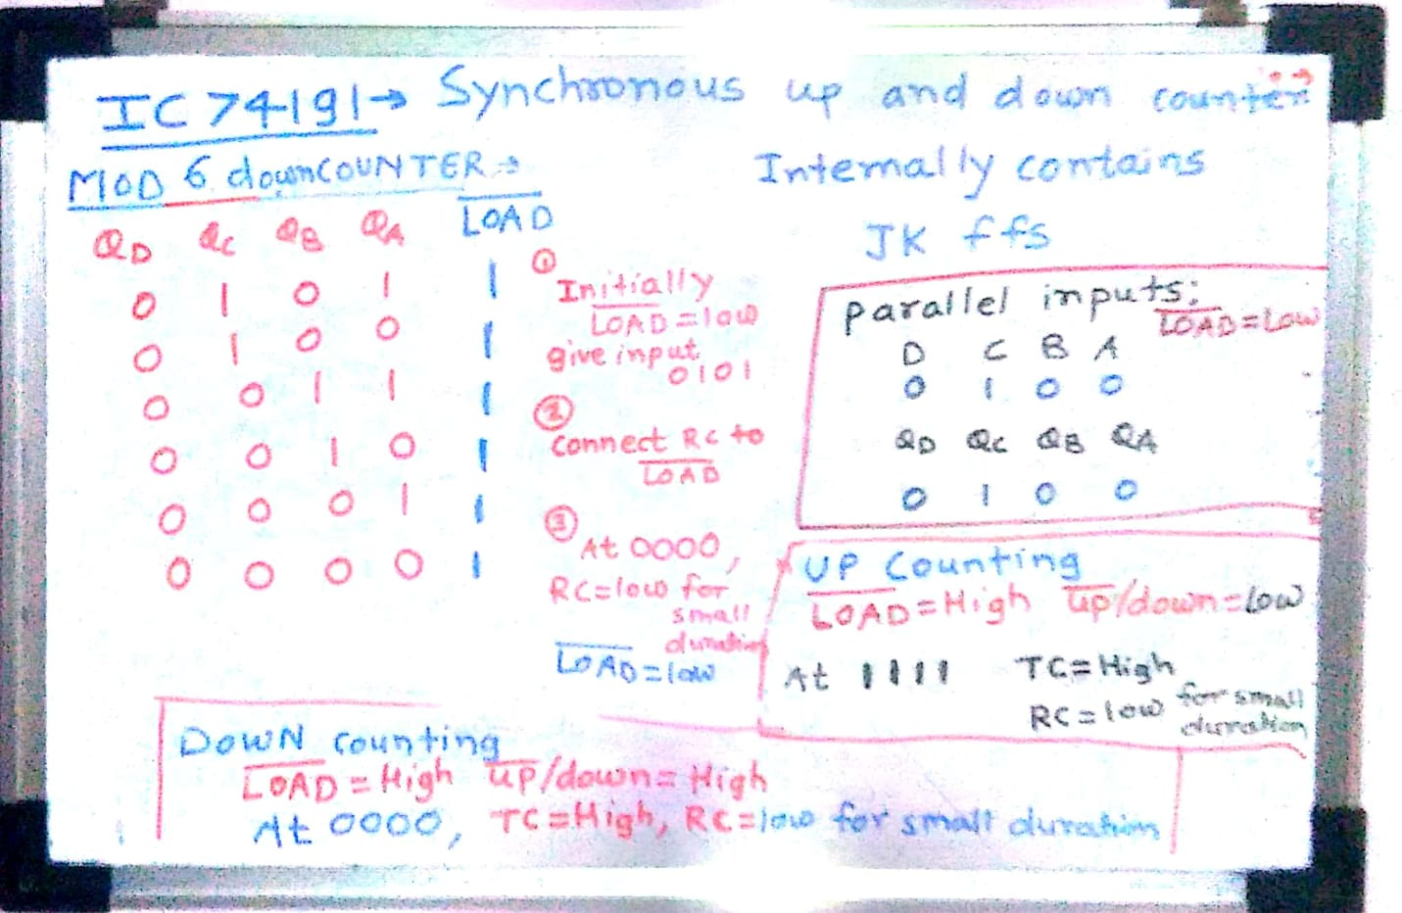

Slide 11
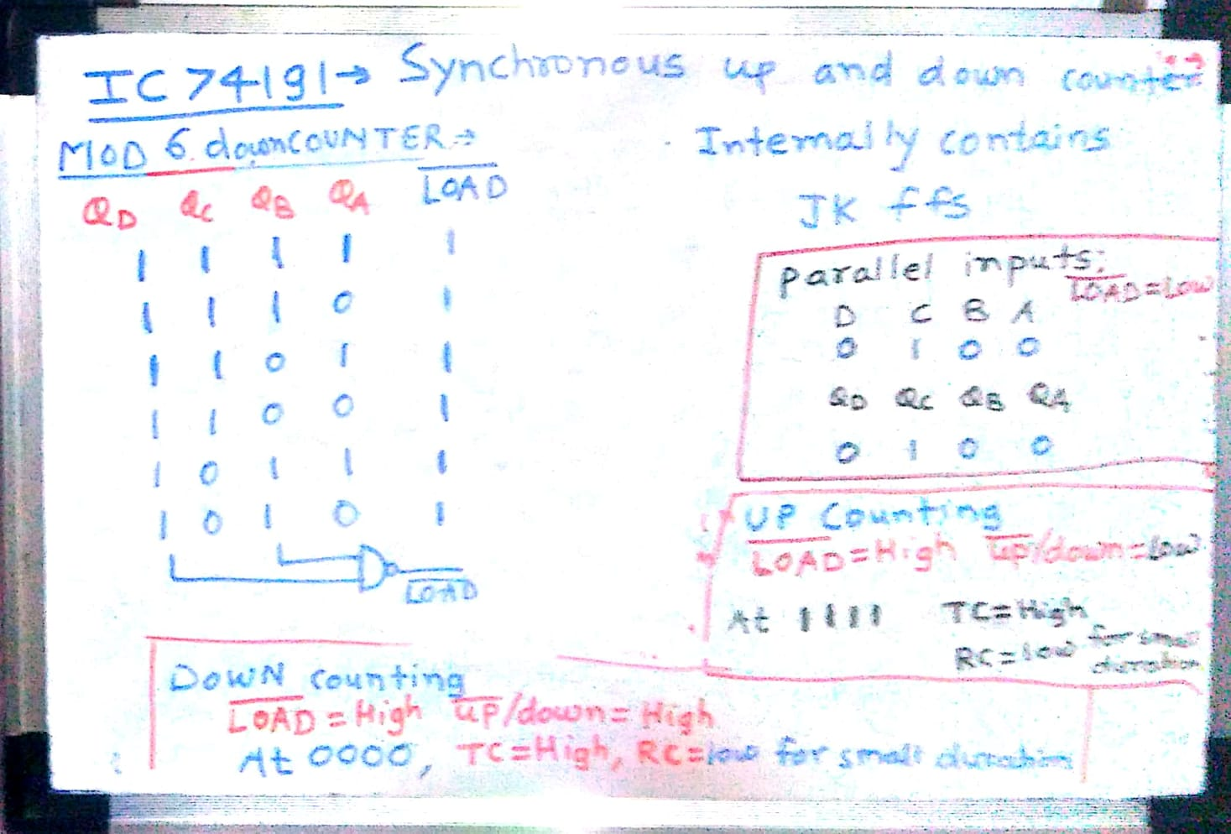
Department of Computer Engineering

Slide 12
Department of Computer Engineering
Thank you

